Slide 1
Productivity Calculator App
Made By:
Ayush Sharma- 19CSU057
Basant Sheoran- 19CSU062
Bhavya Gulati- 19CSU067
Deepanshu Gupta- 19CSU078
Dev Kumar- 19CSU080

Slide 2
Contents
Why this App?
How we made this App?
Exceptions
Packages
File Handling
Project Directory Structure
Project Compilation
Output Results

Slide 3
Why this App?
Helps a person to keep a check on his daily routine
Helps a person to maintain a healthy lifestyle
A person is able to change his/her bad routine habits accordingly
It helps a person to become more efficient in everyday life

Slide 4
How we made this App?
This app is made using JAVA language. We have mainly used following topics to make this app:
Exceptions
Packages
File Handling

Slide 5
Exceptions
An exception can occur for many different reasons like the following:
1. A user has entered an invalid data.
2. A file that needs to be opened cannot be found.

Slide 6
Problem Statement
Productivity Calculator App: A java application to display how many productive hours we have in a day where we can also add, update and delete the routine-tasks in the list.
Definition of Done:
The system should ask user to enter user name and password. On successful login, System asks to create a task list for the logged user.
The system should ask user to enter an option from the selected list of operations(Add, Update, Delete)
The user should enter the routine tasks, category(Productive/Non-Productive) and the hours the task takes to get accomplished. Upon segregation of essential but non-productive tasks, the user needs to calculate the number of productive hours he is left with.

Slide 7
contd…
The system should perform the desired operations on the Productivity_Calculator.txt file for the logged-in user (Add, Delete, Update, display).
The project directory structure should explain about all subdirectories and what kind of files to be kept into particular sub directory.
All configuration data should be kept in properties files. It should maintainable based on different categories.

Slide 8
Project Directory Structure
The project directory structure should explain about all subdirectories and what kind of files to be kept into particular sub directory.
Productivity Calculator App
classes
configs
data
src

Slide 9
contd…
classes
com
ncu
These folders will automatically appear when the programs are compiled respectively according to the compiling commands
exceptions
main
menu
validators

Slide 10
contd…
configs
This folder includes the program of excptions.properties. This program involves all the messages which are needed to be occurred when an exception is thrown. This mainly involves message after invalid username or password in the app.
constants

Slide 11
contd…
Data folder consists of a Tasks.txt file which contains all the tasks of the user which he/she enters. All the tasks which are added in the app are shown here.

Slide 12
contd…
src
com
This folder is made to save all the code files made by us. The code files are saved in the sub-directories according to the topics. This helps in the proper differentiation of the files.
ncu
exceptions
main
menu
validators

Slide 13
Exceptions Folder
Exceptions folder include following three programs
EmptyFileNameException:
MissSpecialCharacterException: It throws an exception when username or password do not contain special characters like @, etc.
UserLengthException: It throws an exception when username’s or password’s length are not up to 8 characters.

Slide 14
Menu Folder
This folder includes following programs
Adding
Deletecmd
Deletefile
Deleterecord
Show
Showfile
Updatehour
Updateroutine
Start
Time

Slide 15
Project Compilation
First compile execution classes
javac -d classes/ src/com/ncu/exceptions/.java
Compile NameValidator class
javac -cp classes/ -d classes/ src/com/ncu/validators/NameValidator.java
Compile menu class
javac -d classes/ src/com/ncu/menu/.java
Compile main.java class
javac -cp classes/ -d classes/ src/com/ncu/main/pmain.java
Run main class
java -cp classes/ com.ncu.main.pmain

Slide 16
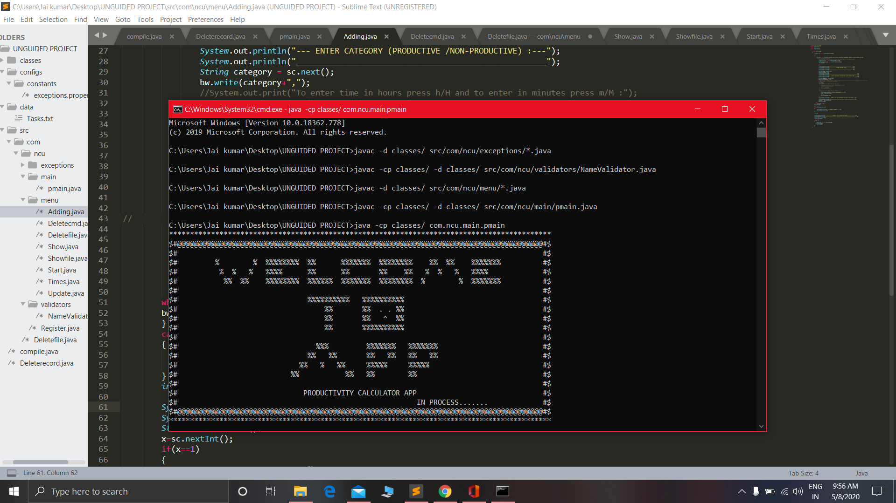
Output Results

Slide 17
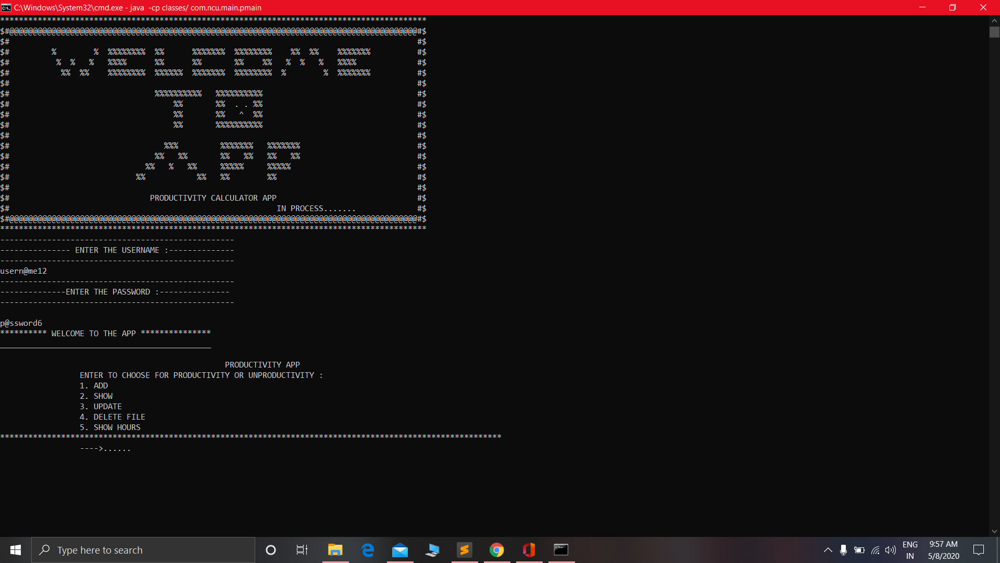
contd…

Slide 18
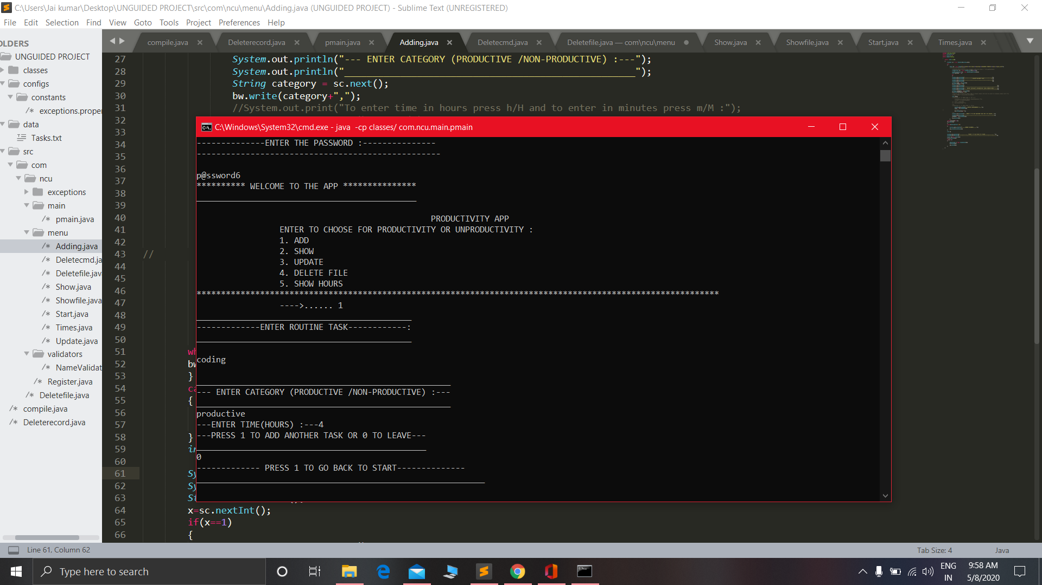
contd…

Slide 19
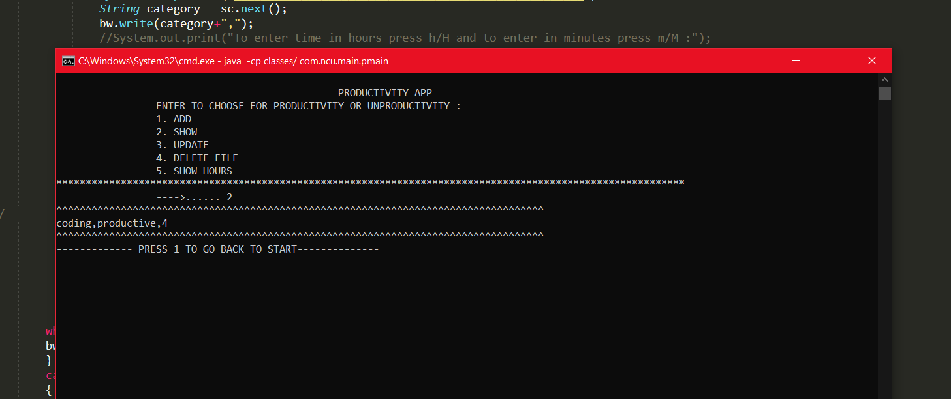

Slide 20
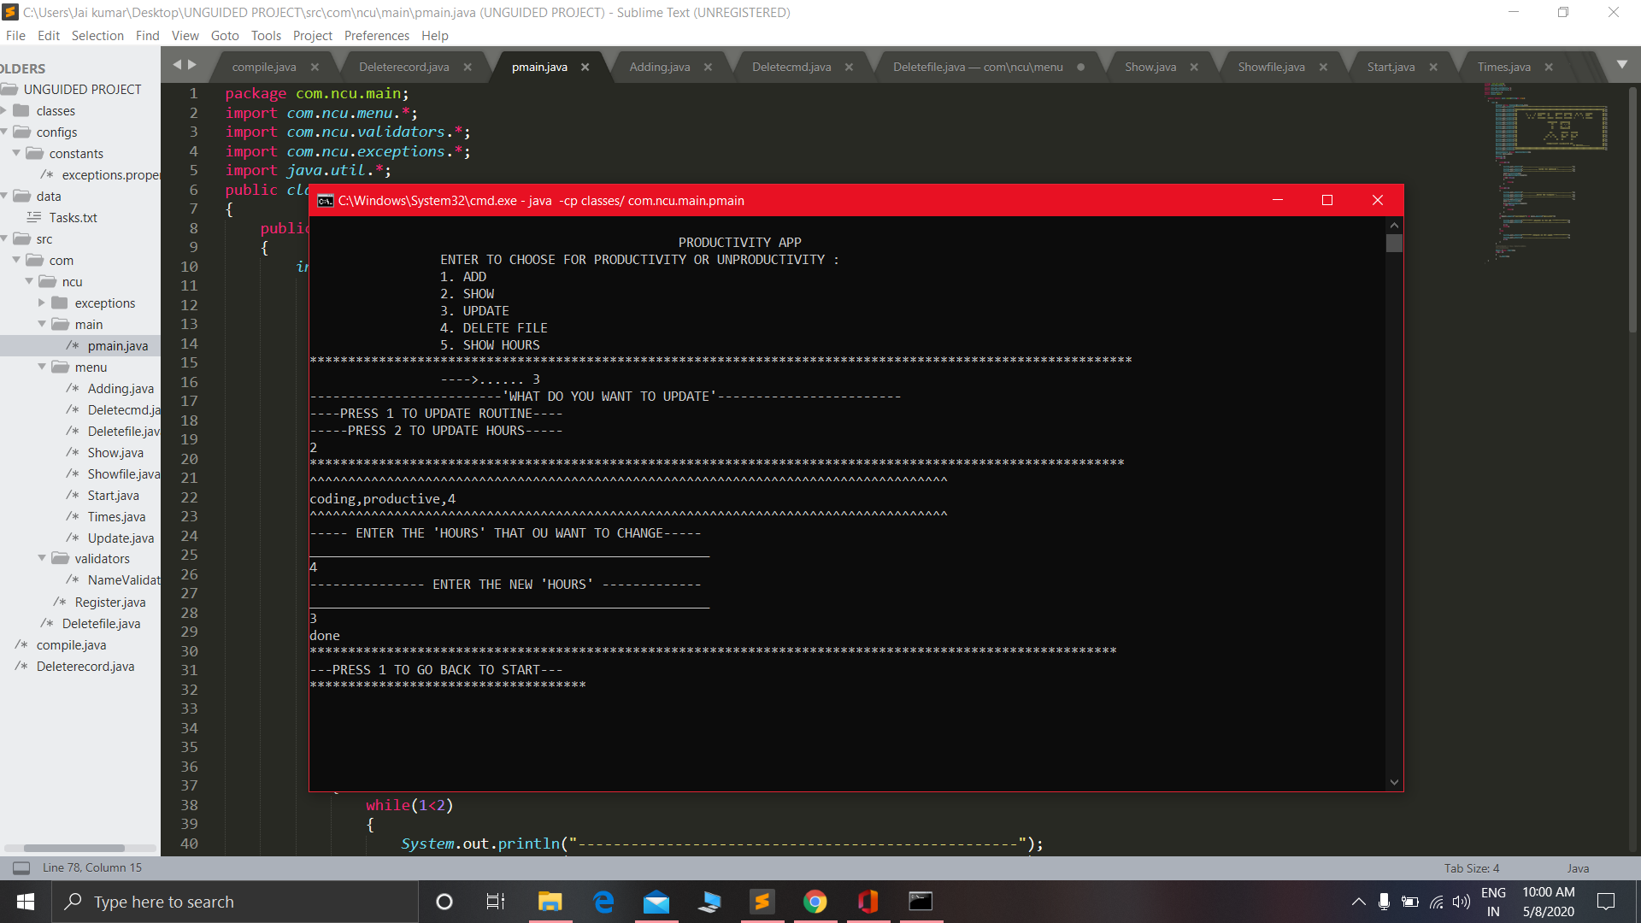
contd…

Slide 21
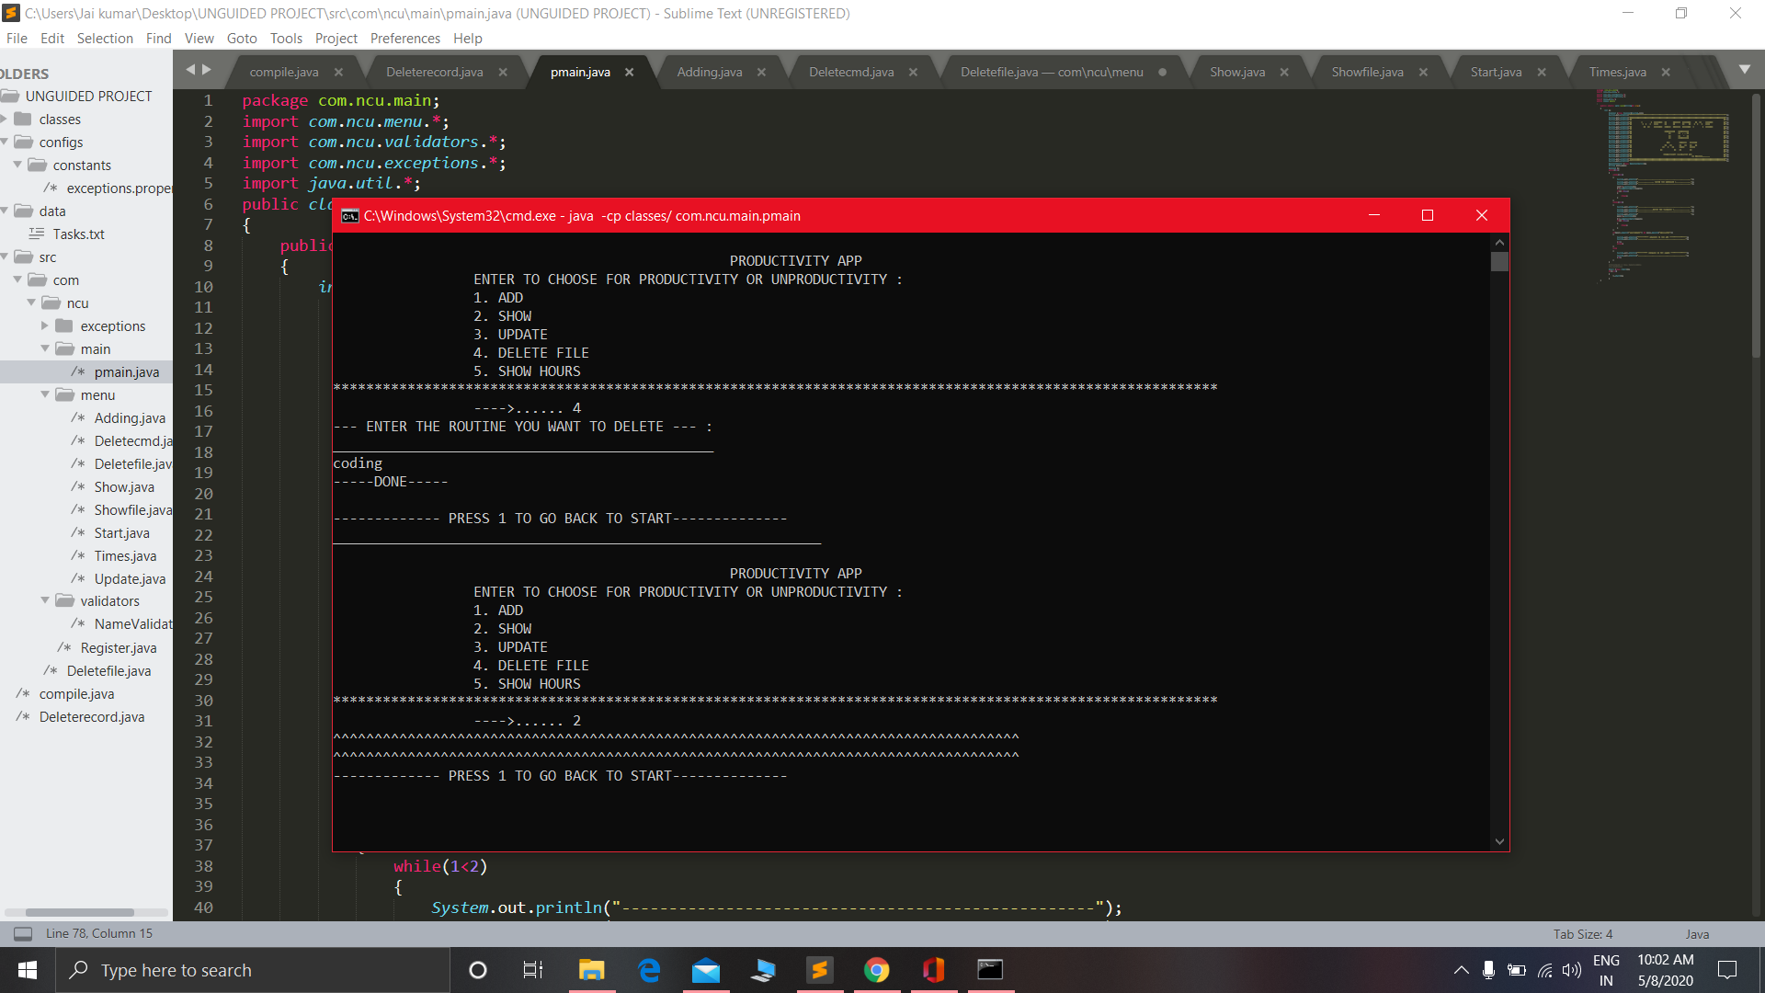
contd…

Slide 22
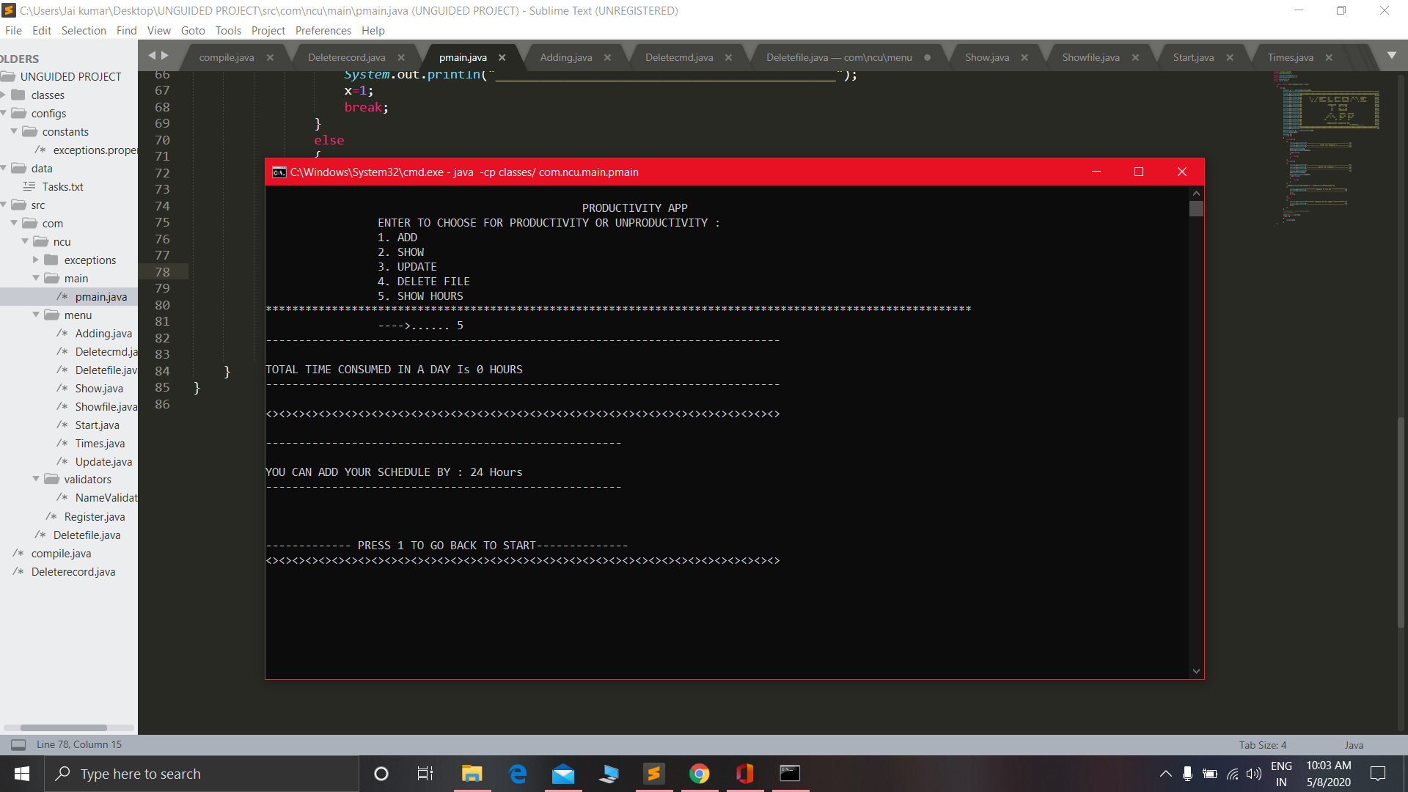
contd…

Slide 23
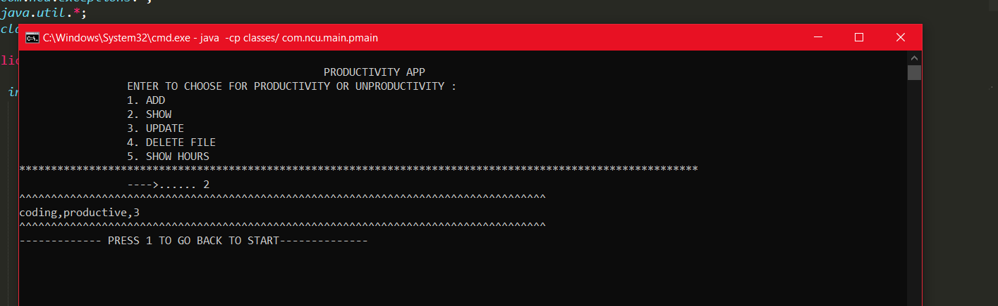
contd…

Slide 24
Thank You

